Slide 1

Principles and Practices of
Lean Manufacturing
Colin Haley
Mike Tulk
Jon Farrell

Slide 2
Lean Manufacturing
Principles and practices
Specific manufacturing examples (former Terra Nova Shoes)

Slide 3
The 7 Major Wastes

Slide 4
Seven Wastes
Most important concept in lean manufacturing is the distinction of the 7 major wastes.
Wastes are also known as “Muda”.
Wastes are defined as unnecessary resource that is required to produce a quality product as defined by the customer.

Slide 5
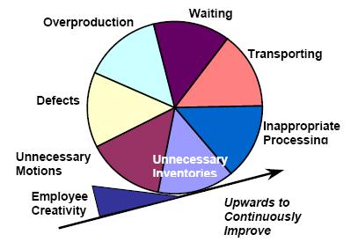
Seven Wastes
Overproduction
Down Time
Transportation
Inappropriate Processing
Unnecessary Inventory
Unnecessary Motions
Defects

Slide 6
Overproduction
Producing more product than necessary.
Creates excessive lead times.
Increases storage cost.
Difficulty of finding defects.

Slide 7
Down Time
Idle products or employees.
Concentrate on bottlenecks will alleviate the waiting waste.

Slide 8
Transportation
Inefficient factory layout.
No value added.
Opportunity for damage.

Slide 9
Inappropriate Processing
Cheap tools instead of expensive ones
Less technology where possible
Several machines rather than one

Slide 10
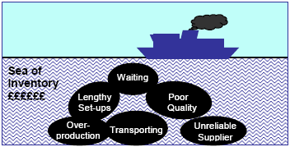
Unnecessary Inventory
Associated cost with excess stocks.
Problems become overlooked since there is excess

Slide 11
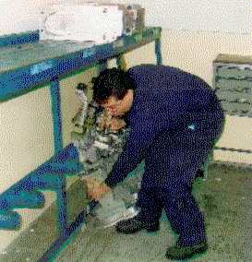
Unnecessary Motions
Keep ergonomics in mind
Misplaced tools.
Searching for materials.

Slide 12
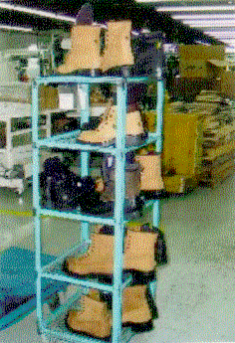
Defects
Defects are goods of low quality.
Wasted material, time and money
As product moves down the supply chain, the cost associated with the defect rises.

Slide 13
The Kaizen Technique
Masaaki Imai (lean’s founding father): Kaizen - “a means of continuing improvements in personal life, home life, social life, and working life”
Workplace - managers and workers working together to make improvements with low capital investments
Kai - to modify or change
Zen - to think about making good or better

Slide 14
Kaizen Strategies/Goals
Elimination of the seven wastes
Teamwork based:Train all employees (kaizen & problem solving)
Communicate ideas up and down company hierarchy; every one is encouraged to seek out and exploit new opportunities
Define clear leadership initiatives
Prioritizing problems
Create a culture where Perfection is perpetually chased

Slide 15
Kaizen Implementation
Practices exist for the successful implementation of Kaizen, which include:
Value Stream Mapping
The 5 Whys
PDCA (Plan, Do, Check, Act)
5-S

Slide 16
Benefits of Kaizen Implementation
Makes the job:
  Easier
  Safer
  Less unpleasant
  More efficient
Saves money and time
Stimulates workers
Creates an atmosphere of harmony and a strong sense of community, family, and belonging

Slide 17
Kaizen Blitz: An Alternate Approach
Definition: A business strategy which promotes rapid implementation of plant improvement ideas.
Improvements
  Small
  Rapid
  Utilize minimal resources

Slide 18
Kaizen Blitz: Strategy
Discover problem
Brainstorm solutions
Apply rapid implementation
Monitor for success

Slide 19
Kaizen Blitz: Benefits
Change is almost immediate
Relatively simple to plan and implement
Required resources are low
Many small improvements can be as, if not more, beneficial than larger scale changes.

Slide 20
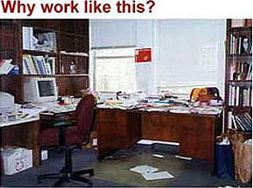

5-S Implementation
Promotes visual management and a clean and safe workplace that results in a high level of organization and efficiency

Slide 21
The 5-S’s
“Straighten” - separating what is and is not needed
“Sort” - a place for everything, and everything in its place
“Shine” - a clean workplace should be an established goal
“Sustain” - adherence to the first three S’s in the 5S program
“Standardize” - continuous use of the first four S’s until they become second nature to employees

Slide 22
Benefits of 5-S
Increased morale
Safety
Non-Value Added activity decreased
Efficiency and organization
Increased quality
Faster Lead Time
Increased creativity, and willingness to contribute among employees.

Slide 23
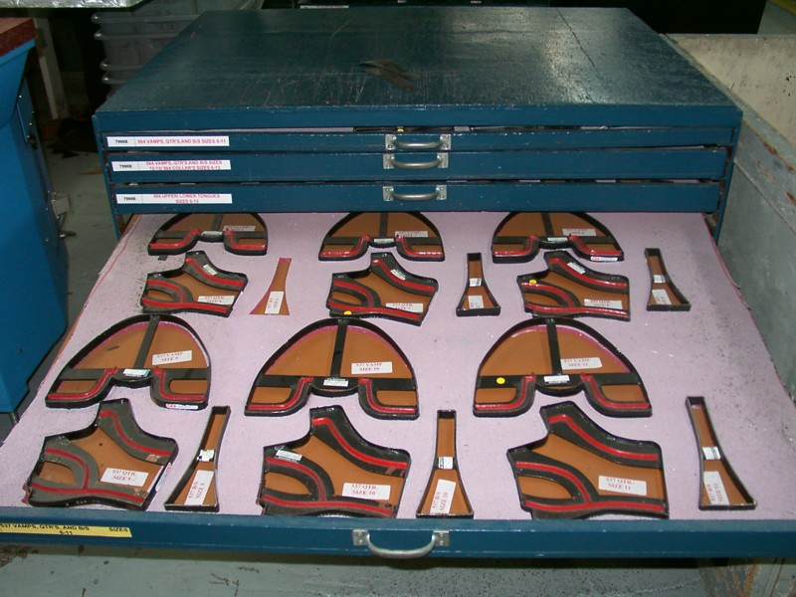
5-S Examples
Shadow board for cutting dies

Slide 24
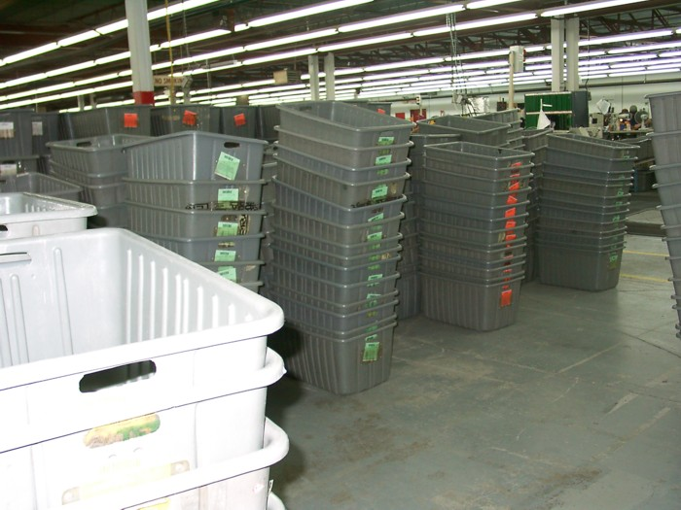
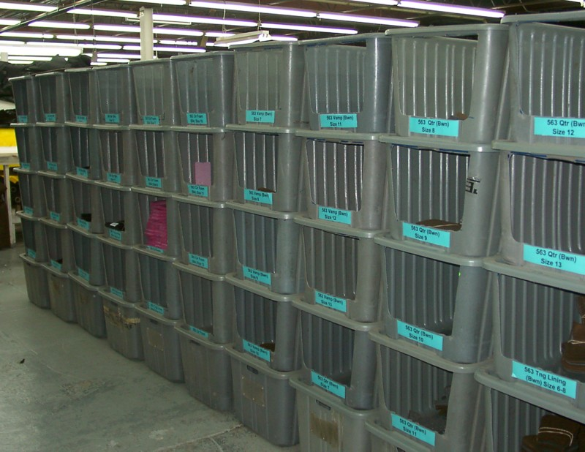
5-S Examples
Before
After

Slide 25
Just-In-Time (JIT)
Technique
Products produced only as they are required
Establish flow processes so there is an even, balanced flow throughout the entire production process
Best suited to processes where the same product is produced continuously
Goal: Generate zero queues & Minimize lot sizes

Slide 26
JIT: Benefits
Reduced inventory levels (improved profits)
Less wastes: improved product quality
Reduced delivery lead times
Reduced costs associated with equipment problems, machine setup, etc.

Slide 27
JIT: Strategies
Balanced workload throughout the factory
Changes in product demand should not result in large fluctuations in production levels
Establish a TAKT time
Minimize setup times to achieve single digit times (improved planning & redesigning processes)
Lead times should be reduced through cellular manufacturing, reducing queue times, etc.

Slide 28
Preventative Maintenance
Idle workers use their time more effectively and maintain workstations to help in the prevention of various problems that would halt production
Advantages of flexible workers:
- Quality inspections
- Operation of several machines

Slide 29
Jidoka
Definition: It is the ability for machines to be self-dependent and error proof without any human interaction.
3 Elements:
  Separate human from machine work
  Machines detect/prevent abnormalities
  “Stop the Line” authority in operation

Slide 30
Key Concepts of Lean
Pokayoke
Kanban
Cellular Manufacturing

Slide 31
Pokayoke
Simple machines and mechanisms rather than complex, high-tech ones
Fool proofs operations and reduces/eliminates mistakes in processes
Devices are usually quite simple, inexpensive, and either inform the operator that a mistake is about to be made or prevent the mistake altogether

Slide 32
Pokayoke (cont’d)
Pokayoke helps minimize defects before they reach the customer
Important to realize Pokayoke is not a solution to the defect problem
Investigation in the defect cause is essential to elimination
Ex. color-coding parts so they can not be mixed up

Slide 33
Kanban
Card system that helps control flow
Very effective in establishing JIT manufacturing goals
Easily understood and requires a relatively simple setup
Card should be attached to a product container and contain essential information (part #, quantities, etc.)

Slide 34
Kanban (cont’d)
There are two types of Kanban systems:
  Production Kanban
  Conveyance Kanban
Production kanban signals the need for the production of more parts
Conveyance kanban signals the required delivery of parts to the next stage of production

Slide 35
Kanban (cont’d)
Environments with a highly fluctuating demand and wide variety of product are less likely to experience success
Smaller kanbans at various sectors of a plant may be helpful

Slide 36
Kanban (cont’d)
Basic Rules of Kanban
Kanban signal only used when the representative product is used
Products are only issued/made when a kanban is received
Only quality components are used
There is no overproduction
Manufacturing follows order in which kanban cards are received
There should be a reduction of kanban cards over time

Slide 37
Cellular Manufacturing
Work cells are central to the idea of one piece flow
Ideally these work cells focus on a low range of similar products
Product continually moves around the cell to each operation until complete at the end of the “U”

Slide 38
Cellular Manufacturing (cont’d)
The u-shaped layout optimizes flow from one station to the next
Benefits include:
  Higher throughput
  Improved coordination
  Strong sense of teamwork
  Improved quality and productivity
  Simplicity of cellular manufacturing

Slide 39
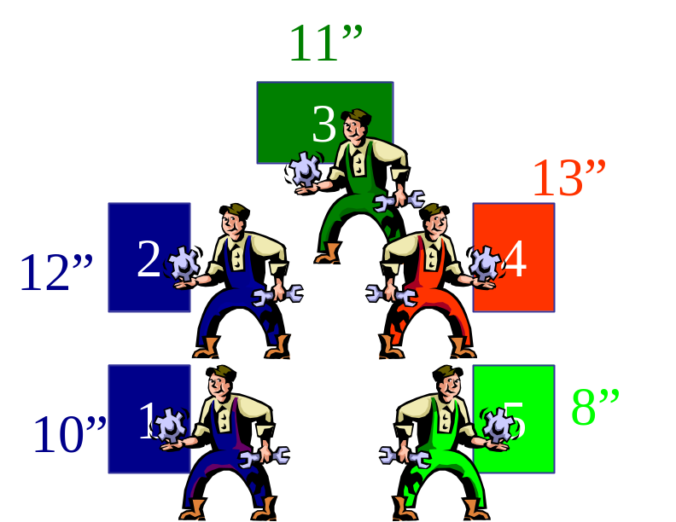
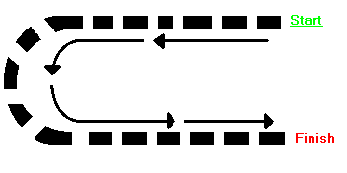
Cellular Manufacturing (cont’d)

Slide 40
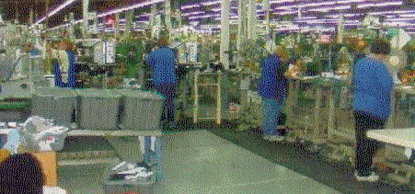
Cellular Manufacturing (cont’d)

Slide 41
Single Minute Exchange of Dies (SMED)

Slide 42
General Problems
Large time losses due to setup are generally accepted in many industries
Expensive, high-tech equipment is often seen as beneficial in saving time and money

Slide 43
Lean Approach
It is often the case that creativity and simplicity is the best solution to these problems
Generally several smaller/simpler machines will be more beneficial

Slide 44
Benefits of SMED
Reduced setup time
Higher efficiencies
Increased capacity
Reduced WIP’s
Lower batch sizes
Increased safety
Increased flexibility
Elimination of waiting
Operators preference
Stockless production

Slide 45
Internal Vs. External Setup
Classification essential to effective SMED system
External Setup: One that may be completed while machine is in operation
Internal Setup: One that requires the shut down of the machine for completion

Slide 46
Internal Vs. External (cont’d)
Primary goal is to change all internal setups to external ones
Reduce length of internal setup if unable to convert to external
Reduce length of all external setups as well

Slide 47
Simple Suggestions
Analysis of setup procedures using videotapes
Use more people where available
Use offline time as maintenance time
Practice makes perfect

Slide 48
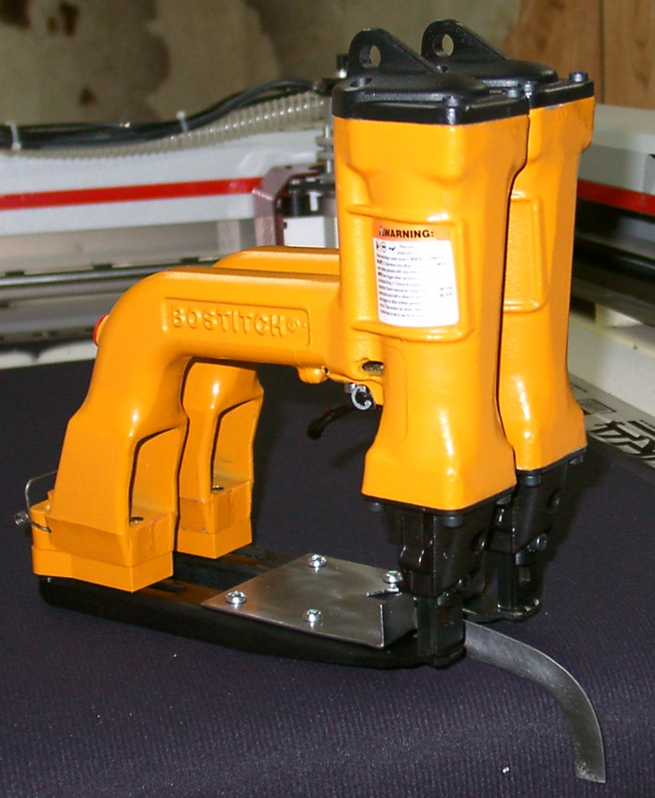
SMED Examples
Split thread bolts
Handles
Toggle clamps
U-shaped washers

Slide 49



Example Tools

Slide 50
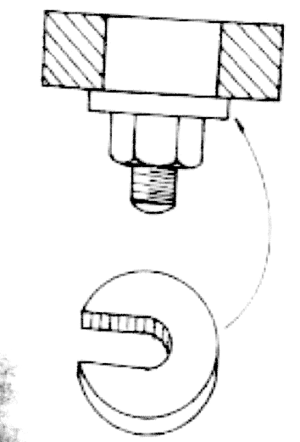
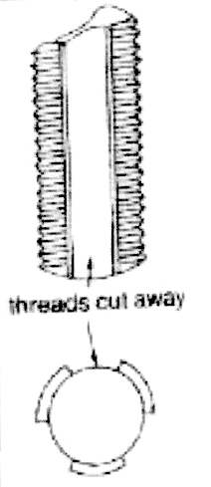
Example Tools (cont’d)
u-shaped washers
Split thread bolts

Slide 51

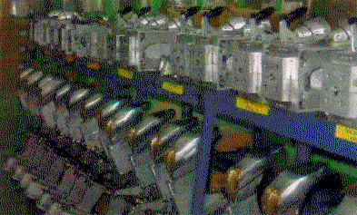
SMED Examples

Slide 52
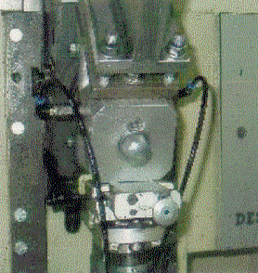
SMED Examples

Slide 53
SMED and Lean
SMED needs to be treated as a constant improvement program
Setup times can not be minimized overnight
Continuous evaluation and exploration of further improvements is absolutely necessary

